Slide 1

EduGuard: Revolutionizing Student Dropout Prevention with AI
Transforming education through intelligent early intervention and data-driven student support

Slide 2

The Dropout Crisis: A National Challenge
25%
50%
$1M
Student Dropout Rate
Higher Unemployment
Lifetime Income Loss
Nearly 1 in 4 students in some regions drop out before graduation
Dropouts face significantly higher unemployment rates
Average earnings gap between graduates and dropouts
The ripple effects extend beyond individual students, impacting community well-being, school funding, and institutional reputation when students leave prematurely.

Slide 3

Why Students Drop Out: Complex, Multi-Factorial Causes
Academic Challenges
Chronic struggles with coursework and falling behind grade level expectations
Attendance Issues
Chronic absenteeism and behavioral problems disrupting learning
Socio-Economic Barriers
Financial hardships and family responsibilities competing with education
Mental Health Concerns
Anxiety, depression, and social isolation affecting student engagement
Traditional reactive approaches often fail to identify at-risk students early enough, missing critical intervention opportunities.

Slide 4

Introducing EduGuard: AI-Powered Early Detection & Prevention
Machine Learning Analytics
Predictive Accuracy
Identifies dropout risk with high precision before students become disengaged, enabling proactive intervention strategies
Analyzes comprehensive student data including attendance patterns, academic performance, behavioral indicators, and socio-economic factors
EduGuard provides educators with actionable insights and personalized intervention recommendations tailored to each student's unique risk profile.

Slide 5

How EduGuard Works: From Data to Action
01
02
Seamless Integration
Real-Time Analytics
Connects effortlessly with existing school information systems and learning management platforms
Generates dynamic risk dashboards for teachers, counselors, and administrators with live updates
03
Targeted Interventions
Enables personalized support through mentoring programs, tutoring services, counseling, and family engagement initiatives

Slide 6
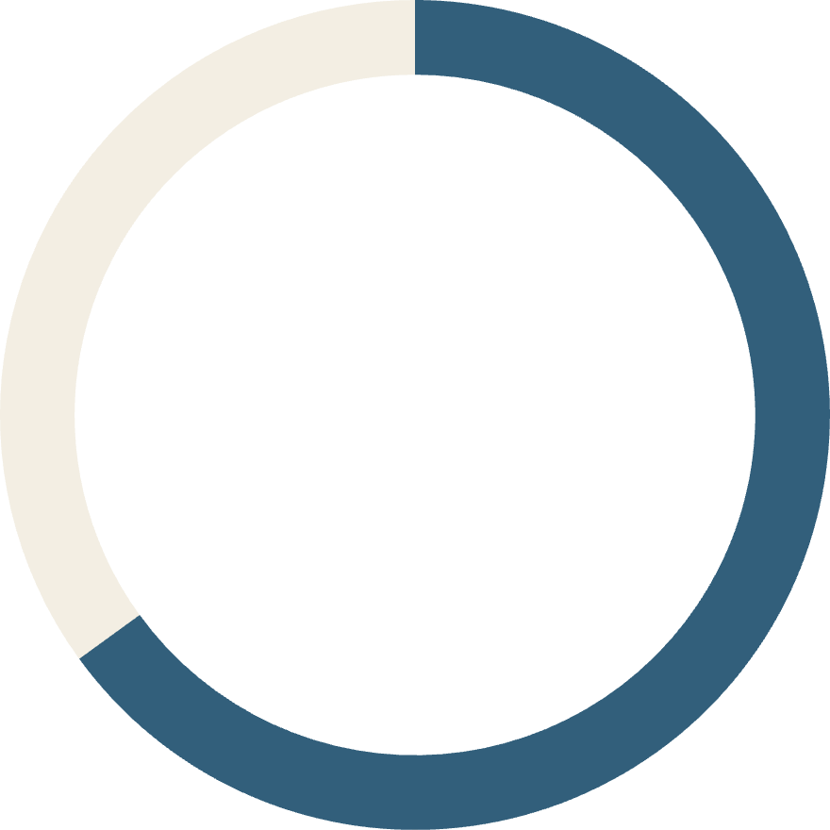
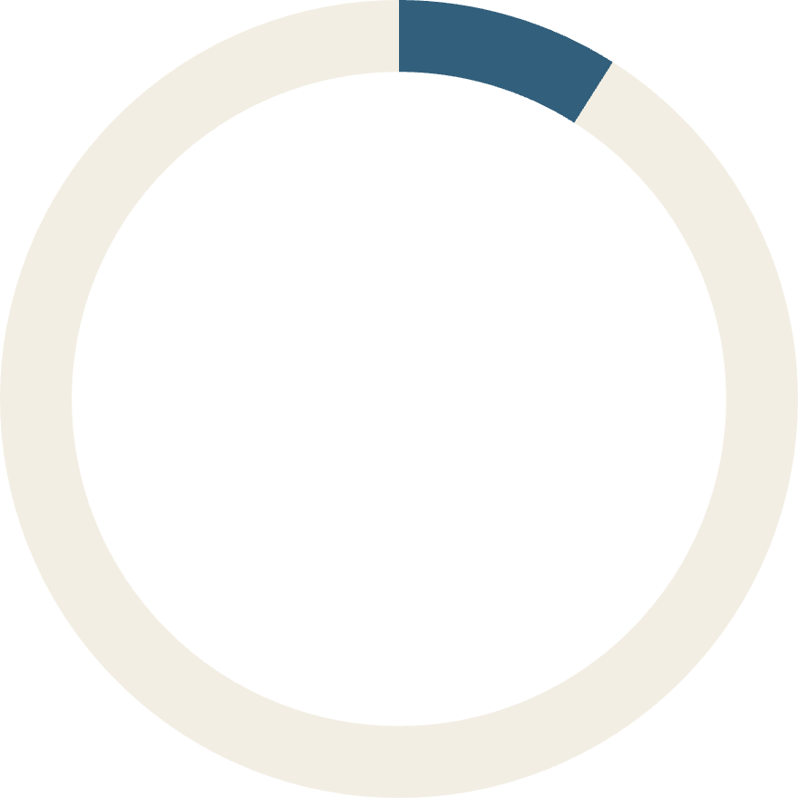
Real-World Impact: Case Studies & Results
65%
9%
Graduation Rate Improvement
Dropout Reduction
Mississippi community colleges using DropGuard™ achieved remarkable results within 3 years
Latin American pilot programs demonstrated significant improvements at minimal cost
Participating schools report enhanced attendance rates, increased student engagement, and dramatically improved communication channels among staff, students, and families.

Slide 7




EduGuard's Unique Advantages
Advanced AI Models
Personalized Solutions
Combines ensemble and deep learning algorithms for robust, accurate predictions
Tailored intervention recommendations based on individual student risk factors and learning profiles
Multi-Tiered Support
Aligned with best practices from the National Dropout Prevention Center for comprehensive intervention

Slide 8




Building a Supportive School Climate with EduGuard
Community Partnership
Facilitates meaningful collaboration between educators, families, and local community resources for comprehensive student support
Inclusive Environment
Promotes safe, welcoming school climates that foster genuine student belonging and emotional resilience
Educator Empowerment
Empowers adult advocates with sophisticated data-driven caseload management tools and professional training

Slide 9

The Future of Dropout Prevention is Here
"AI-driven systems like EduGuard are fundamentally transforming how schools identify, understand, and support at-risk youth before they reach the point of disengagement."
Lives Transformed
Communities Strengthened
Early intervention saves lives and dramatically improves long-term outcomes for vulnerable students
Stronger graduation rates build more resilient, economically stable communities for everyone
Join the educational revolution to ensure every student has the opportunity to reach their full potential and succeed.

Slide 10






Take Action: Partner with EduGuard Today
Implement EduGuard
Unlock powerful predictive insights and transform your approach to proactive student support
Empower Educators
Equip your teaching staff with cutting-edge tools to keep students engaged, motivated, and on track
Transform Futures
Together, let's end preventable dropouts and build brighter educational futures for all learners

